Slide 1


Slide 2


Slide 3
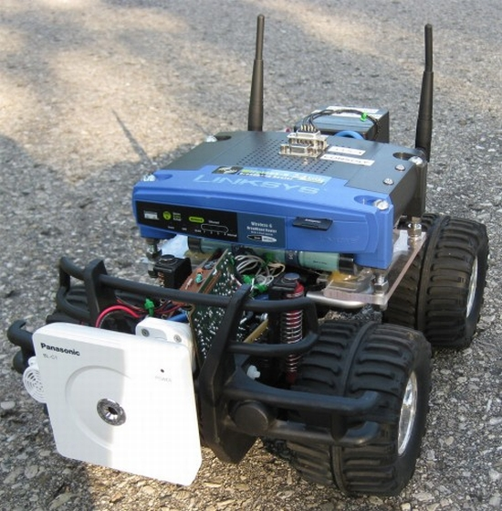
ROBEX

Slide 4
ROBEX
ROBEX IS A ROBOT WHICH EXTINGUISHES FIRE DURING AN EMERGENCY

Slide 5
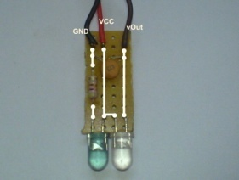
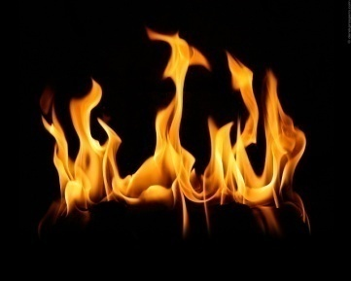
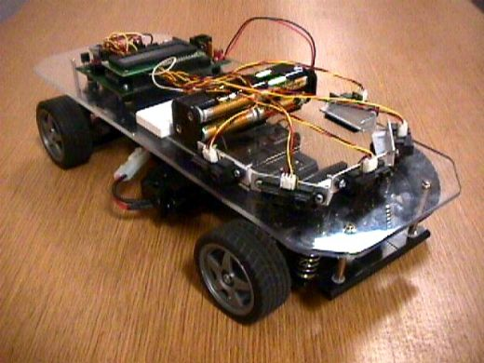
ROOM 1
ROOM 2
ROOM 3
ROOM 4
ROOM 2
ROOM 3
ROOM 4

Slide 6

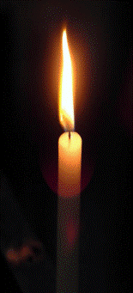
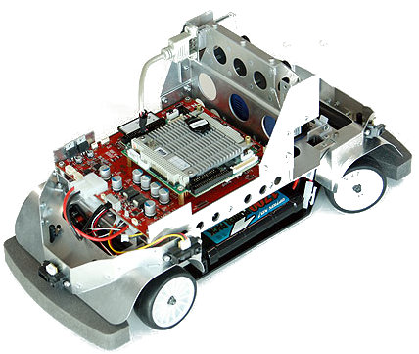
RF signals
IR emitted

Slide 7
ROBEX detects IR emitted by flame and moves towards it

Slide 8
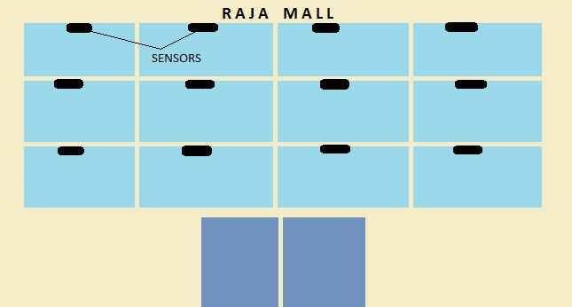
IR sensors are fixed in all rooms of the office
3a
3b
3c
3d
2a
2b
2c
2d
1a
1b
1c
1d

Slide 9
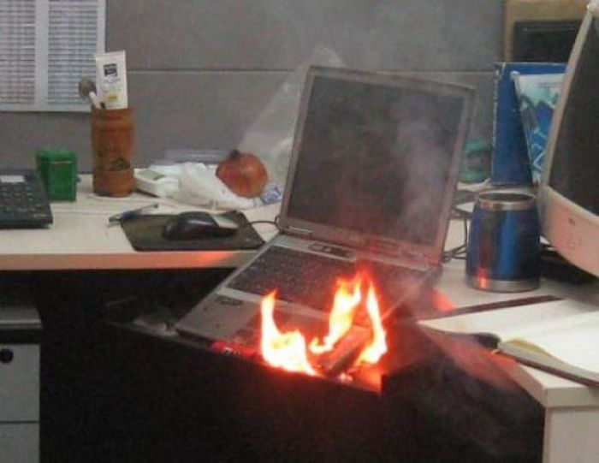
Now fire breaks out in room 2c

Slide 10
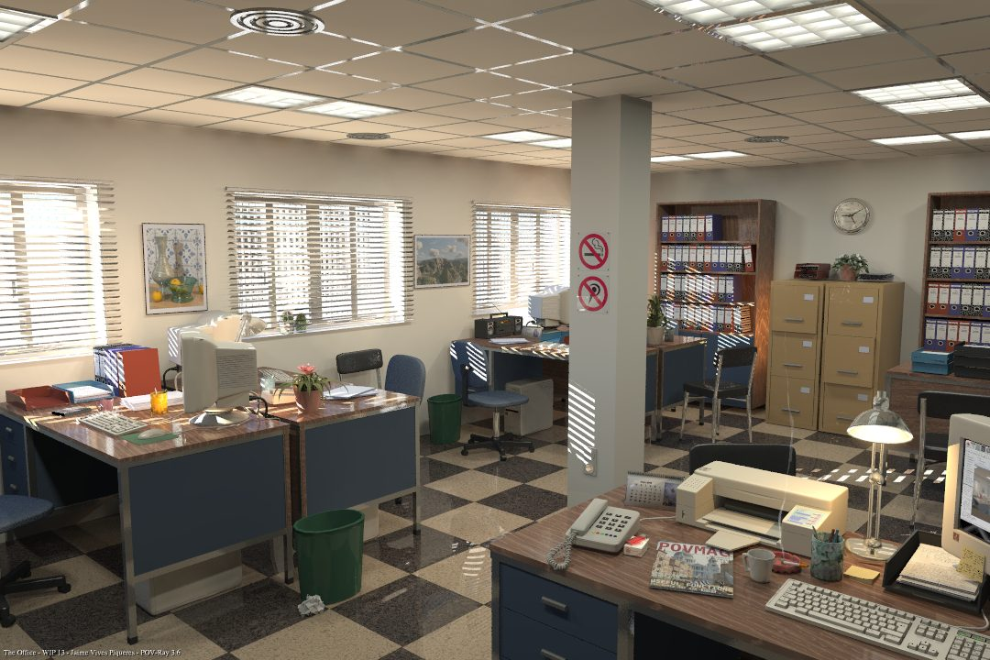
Detection of IR
The IR rays emitted by the flame is detected by the IR sensor in room 2c.
IR sensor

Slide 11
RF module 1 transmits RF signals
The RF module1 with RF encoder which is coupled with the IR sensor sends the address of the room through RF signals to ROBEX which can be placed at a proximity of 200 meters or nearly 1/5th of a KM.

Slide 12
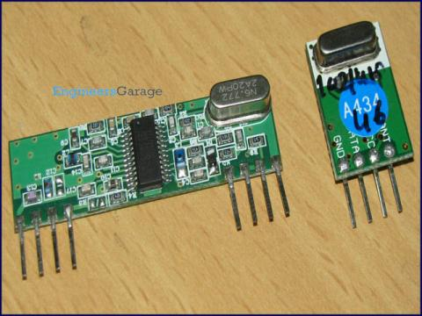
RF module 2 in Robex receives RF signals
Now the RF module 2 with the corresponding decoder in ROBEX receives the RF signals.

Slide 13
ROBEX reaches the room
As soon as the RF is received the ROBEX reaches the room in no time where the fire has broken out using the address received by the RF module 2.

Slide 14
ROBEX searches for the fire
As soon as the robex reaches the room the IR sensor embedded in it starts searching for the largest fire as it emits large amount of IR using the IR sensor fixed in ROBEX.

Slide 15
ROBEX extinguishes largest fire
Robex moves near the flame and the thermister fixed in it detects the flame and stops in front of the flame.
ROBEX then extinguishes it using CO₂ or any other extinguisher.

Slide 16
ROBEX again searches for fire.
Once ROBEX has extinguished the largest flame it starts rotating about its center, searching for any further developments in flame.

Slide 17
ROBEX extinguishes fire
After detecting the other flames ROBEX extinguishes all the other flames sequentially.

Slide 18
TRUTH TABLE OF WORKING
RF RECIEVER | THERMISTOR | MOVEMENT | EXTINGUISHER | SEARCHING
0 | 0 | 0 | 0 | 0
0 | 1 | 0 | 1 | 0
1 | 0 | 1 | 0 | 1
1 | 1 | 0 | 1 | 0

Slide 19
FEATURES OF ROBEX
Since we have used RF encoder –decoder no:HT12e/HT12d , 4096 combinations are possible. So ROBEX can be used in mega malls and offices of about 4000 rooms to extinguish fire.
The range of RF is 200 metres or 1/5th of a kilometre. So it can be used even in larger malls and multi national company offices.
The cost of ROBEX is 5000 only but the cost of HUMAN LIFE IS INVALUABLE.

